Slide 1

Getting started…Routes to Publishing
Paul Crampton
Director of the Health Professions Education Unit,
Co-EiC, The Clinical Teacher
contact: paul.crampton@hyms.ac.uk
Notes:
Getting started in… routes to publishing (writing up, presenting and dissemination)

Slide 2
How do you share your innovations with the world?!

Slide 3
Do you consider writing for publication to be a painful process?
I’d rather a fork in the eye
b) It’s delightfully unpleasant
c) It’s not so bad
d) I love it!

Slide 4


This Photo by Unknown Author is licensed under CC BY-ND

Slide 5
Today’s talk…
Overview of health professional education journals
Top tips for authors
Clinical Teacher article types
Support and development

Slide 6
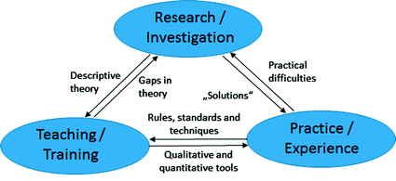
What are your professional identities?
Teaching-Research-Practice Nexus
Schneider P., Folkens L., Busch M. (2018) The Teaching-Research-Practice Nexus as Framework for the Implementation of Sustainability in Curricula in Higher Education. In: Leal Filho W. (eds) Implementing Sustainability in the Curriculum of Universities. World Sustainability Series. Springer, Cham

Slide 7
>100 journals publish health professional education scholarship

Slide 8
Consider the Audience
Consider the journals that you read - Could one of these be appropriate for your work?
What do your peers suggest?
​
What journals were your references published in?
​
Are you seeking a broad audience or a specialized audience?

Slide 9

Publishing metrics
Audience
Key messages
Type of article
Speed of review/
dissemination
Editorial reputation
Methodological rigour

Slide 10
Author Guidelines
Ensure you fully understand these key factors before submitting your manuscript:
Manuscript Formatting
Scope & Fit
Submission Process
Open Access & Copyright
Peer Review Process
Data Sharing & Ethics
Figures & Tables
Revision & Appeals
Author guidelines differ by journal.
Review them carefully to understand the expectations and ensure a smooth submission.

Slide 11

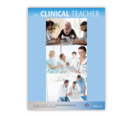
Founded in 2004
Multi-professional, international journal
Platform to share:
Practical experiences
Teaching innovations
Scholarly activities

Slide 12
Article types
Research Article (3,000 words, max 30 references)
Background, Methods, Findings, Discussion, Conclusion
Review Article (4,000 words, max 60 references)
Background, Methods, Findings, Implications
Innovation, Implementation, Improvement (III) (1,500 words, 15 references)
Allow authors to demonstrate scholarly approaches to health professions education design, implementation & evaluation.
Background, Approach, Evaluation, Implications

Slide 13
Perspective papers
The Clinical Teacher’s Toolbox (1500-2000 words, 15 references)
Focus on describing ‘tools’ and providing recommendations to enhance learning and teaching in clinical education. (e.g. ‘Supporting international graduates to success’)
How to… (1500 words, 15 references)
Share research-informed guidance on designing, implementing & evaluating an initiative. (e.g. ‘How to write a good research question’)

Slide 14
Perspective papers
Viewpoint (1500 words)
Share a perspective on a topic of interest & importance to multi-professional teaching community. (e.g. ‘A call for spaced repetition in medical education’)
Conference perspective (1500 words)
Key learning points from a relevant health professional education conference they have attended

Slide 15
Early Career Scholarship section
Masters, PhD, MD research projects.
Research Articles, review articles
Innovation, Implementation, Improvement (III papers)

Slide 16
Postdoctoral special issue
Research Articles, review articles
Innovation, Implementation, Improvement (III papers)
Deadline: 30th June 2026

Slide 17
Online
Submission
Choosing the right journal
Initial Screening
Submitted papers undergo a preliminary check to ensure compliance with the journal's author guidelines; including format, length, language quality, and figure requirements.
Plagiarism Check
All submissions are screened for plagiarism using specialized detection software.
Journal Submission System
Authors must create an account in the journal’s online submission system (note: a separate account may be required for each journal).
Accurate Author Information
Carefully follow the submission steps and ensure the author list entered matches exactly with the manuscript. Incomplete or mismatched author details may cause delays.
Editorial Support
If you have questions or concerns, contact the journal’s editorial office first, they are your primary point of contact rather than the Editor directly.

Slide 18


Slide 19
How to make your work appeal to journals?

Slide 20
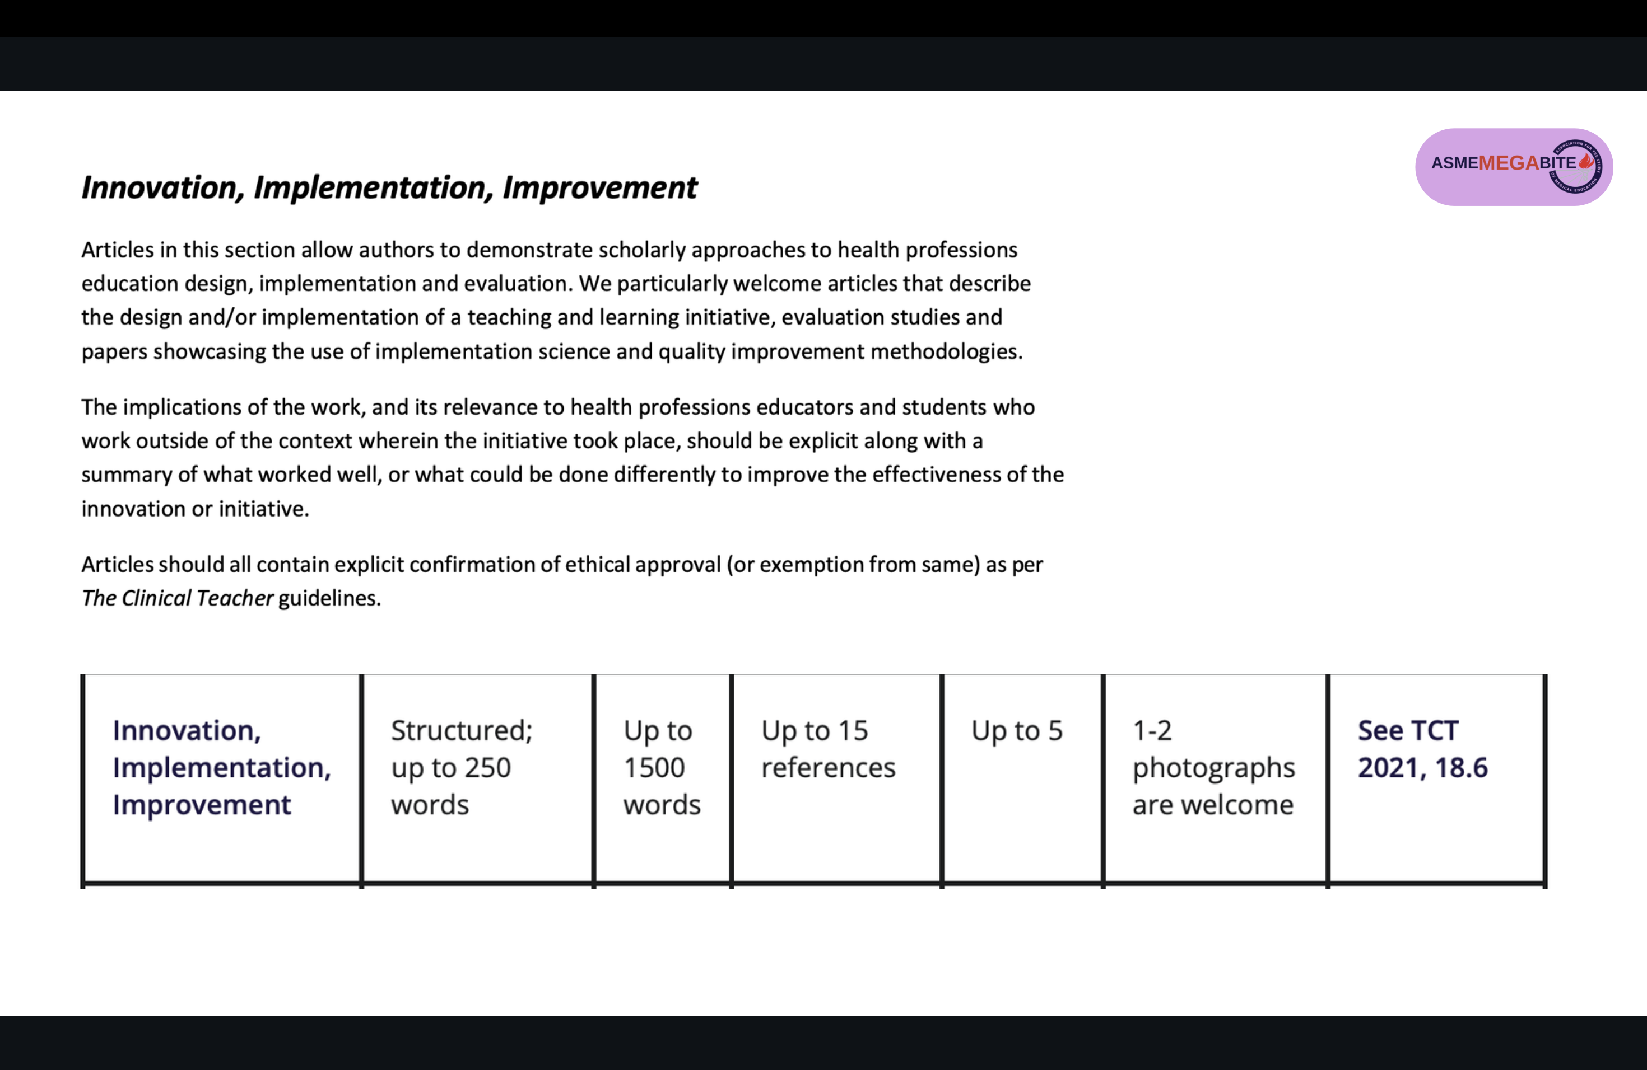
Notes:
in the tortous road of academia, there is the clinical teacher

Slide 21
Key areas to consider
What is the innovation? LOs, learners
What are the key lessons learned?
How has the information informed change and improvement?
What can others learn?
For an interprofessional, international journal, how is the innovation relevant to other medical disciplines and health professions?

Slide 22

A useful heuristic
Problem
Gap
Hook
(Lingard, 2015)
This Photo by Unknown Author is licensed under CC BY-ND

Slide 23

Jen Cleland
Read the journal’s aims, objectives and mission
Ask yourself – does my study fit within these parameters and norms
Write in ways that are attractive to target journals
Reference: Good advice from the deputy editors of Medical Education: The sequel, Feb, 2022

Slide 24
David Cook
Do not forget the abstract! Your article will live or die by it, as most people will never read past the abstract.
Brevity is the soul of wit. It is harder to write a short paper than a long one!

Slide 25
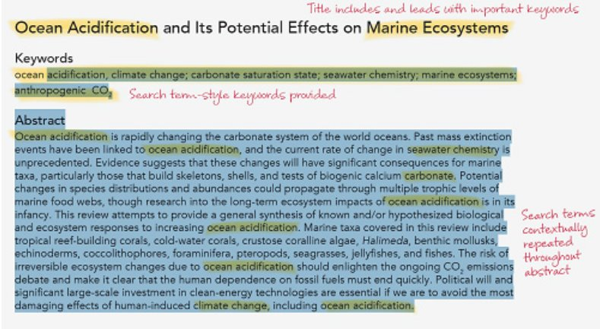
What makes a good title and abstract?
In 10-20 words, title your work by describing what the article is about, and your key finding.
A good research title should offer a brief explanation of what the article is about, it’s the first opportunity to draw in readers before they decide whether they want to read more.
Include keywords up front and throughout your article title and abstract.
Try searching your keywords on Google or other search platforms and look at examples.
Place essential findings and keywords in the first couple of sentences of your abstract.
Describe impact and significance of findings.

Slide 26
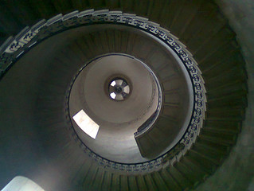
Writing
Convince the reader of the need for your study (Karen Hauer)
Make the writing accessible, terminology (Karen Mattick)
Perspectives (Pim Tuenissen

Slide 27
Support and development for early career researchers

Slide 28


https://asmepublications.onlinelibrary.wiley.com/doi/pdf/10.1111/tct.70408

Slide 29
Mentorship
Focus your research interests. Select specific areas of interest
Formal training
Inclusive belonging
Networking
Search for grant and award opportunities
Join a journal club
Disseminate your work
Burgess, A. and Crampton, P.E., 2026. Clinical Education Scholarship and Research: Getting Started. The Clinical Teacher, 23(3), p.e70408.

Slide 30
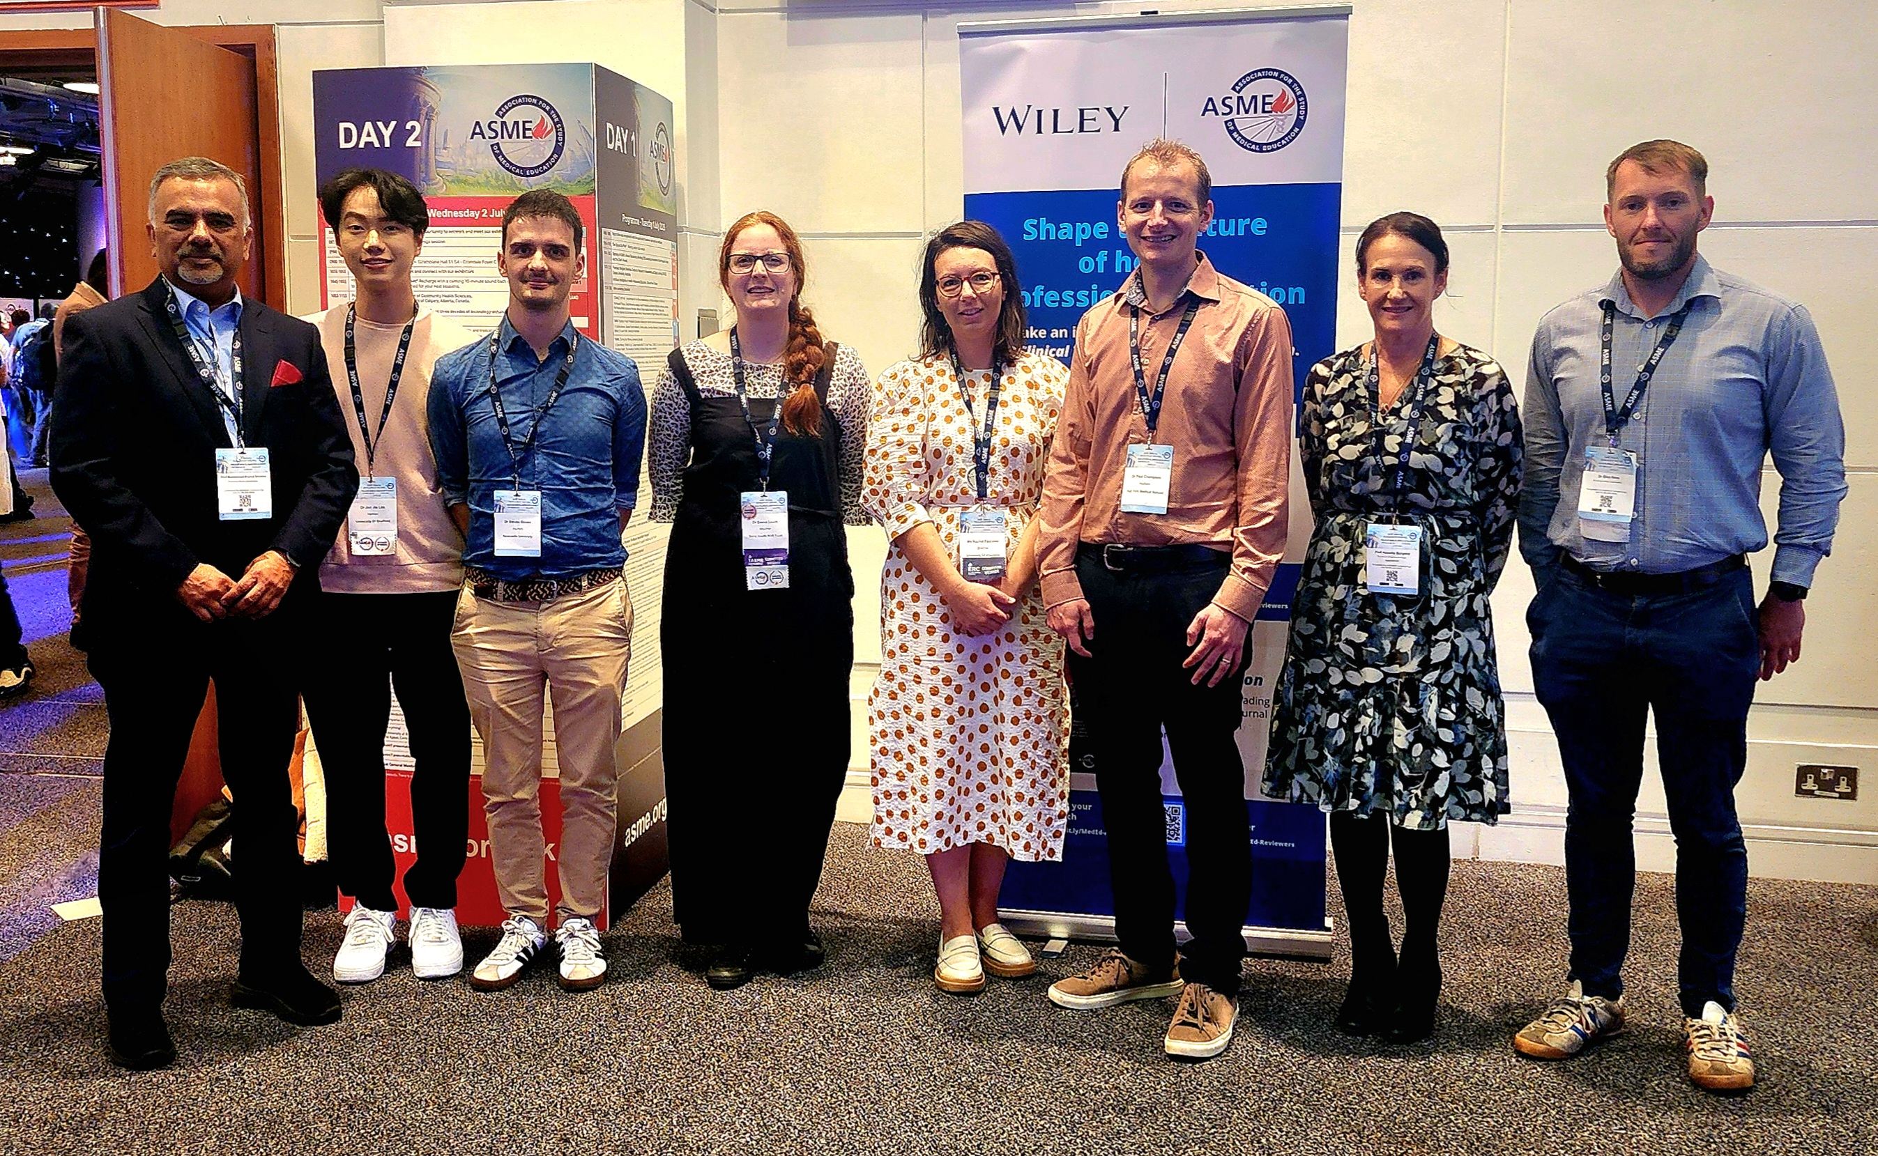

The Clinical Teacher
“New Voices in Health Professions Education” Award
https://www.asme.org.uk/awards/tctnewvoices/
Established: 2021
Aim: equip early-career health professions educators & researchers with the essential skills and knowledge required for peer review.
Eligibility: Individual ASME members
(next round opening around summer 2026)

Slide 31
2025 New Voices group:
19 participants
UK (n= 7)
Hong Kong (n=1)
Canada (n=1)
Malta (n=1)
United States (n=1)
Malaysia (n=2)
Singapore (n=1)
South Africa ( n=2)
Hong Kong (n=1)
Ireland (n=1)
Dubai (n=1)
Year | Number of participants
2025 | 19
2024 | 17
2023 | 4
2022 | 3

Slide 32
Supporting your development…
Med ed. Annual internship programme
Peer review
ASME

Slide 33
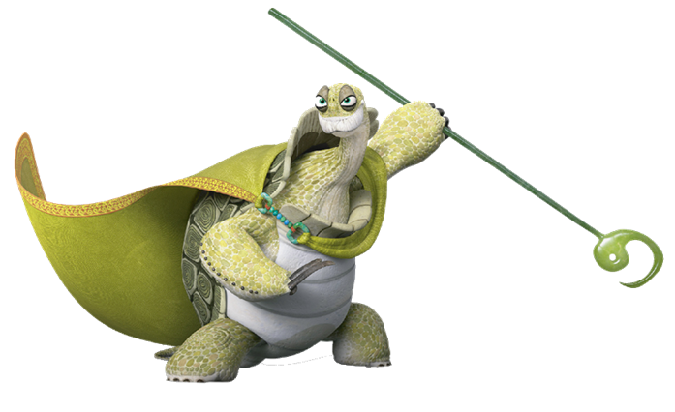


Overview of health professional education journals
Top tips for authors
Support and development

